Slide 1
Lab 2 - Simulator
r09921006 莊志淵

Slide 2
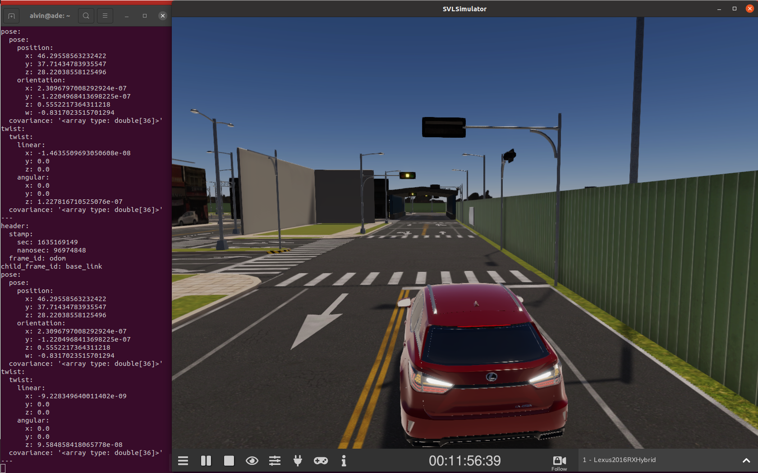
Location #1

Slide 3
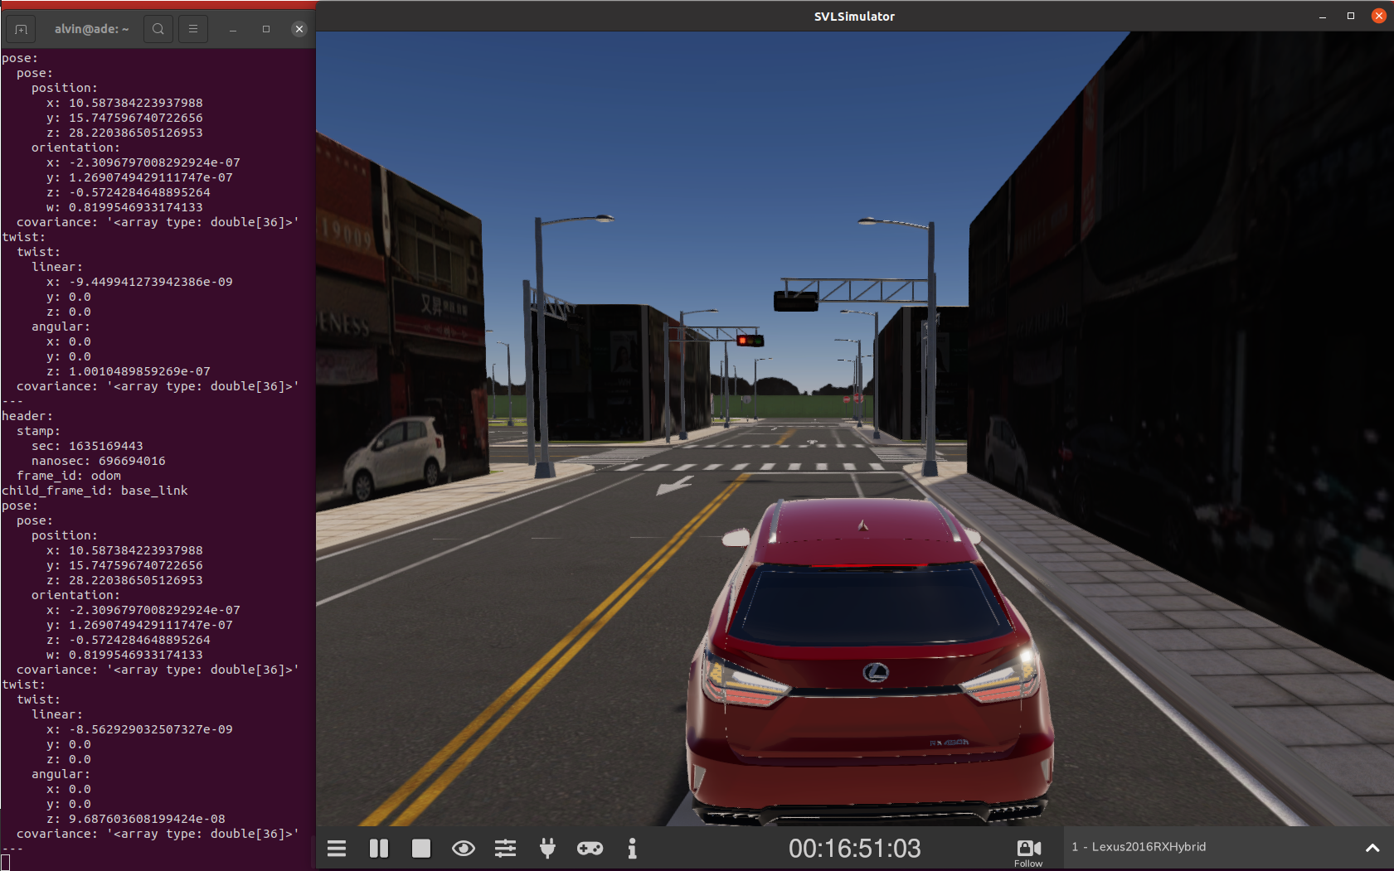
Location #2

Slide 4
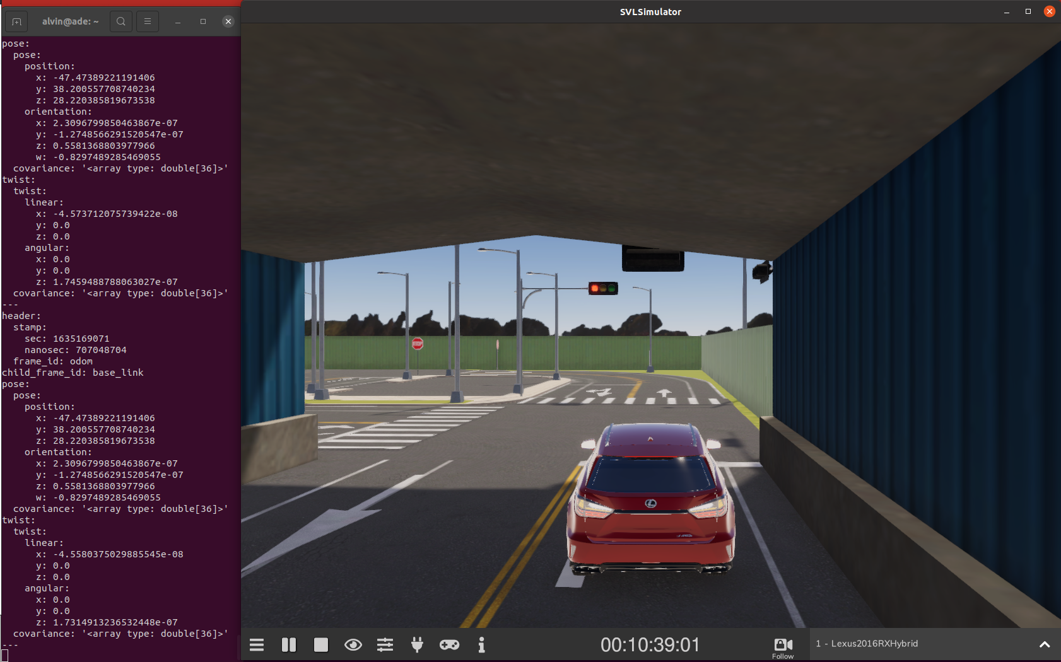
Location #3

Slide 5
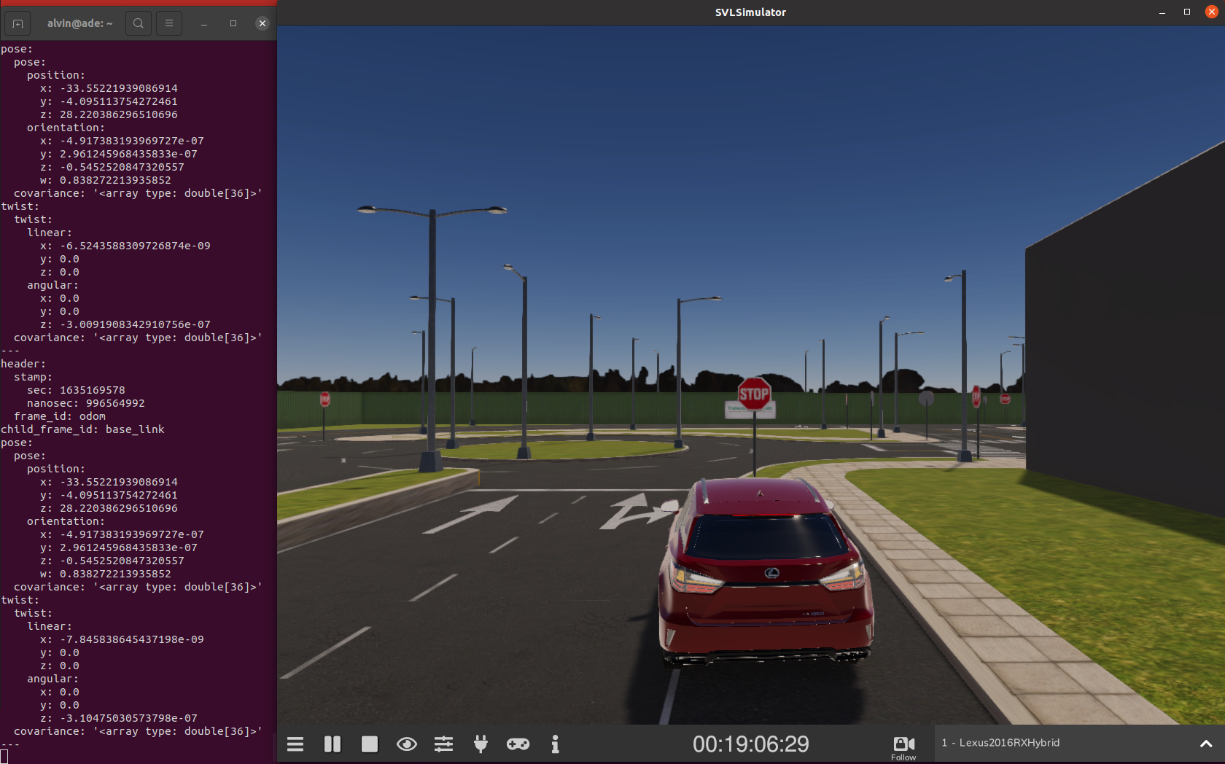
Location #4

Slide 6
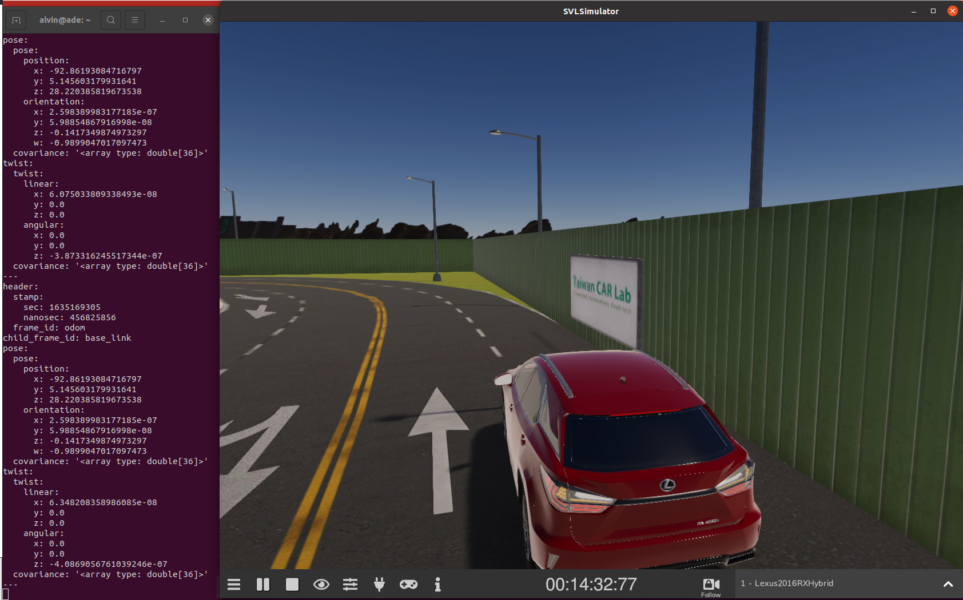
Location #5

